Slide 1


Sampling: Choose Wisely.
A LOOK AT Different types of Sampling Techniques
Dr. Abhik R. Roy

Slide 2
Considering two TYPES OF SAMPLING
Nonprobability
Probability

Slide 3
Nonprobability
Probability is usually unknown.
Does not rely on numerical data.
Inability to generalize to any populous.

Slide 4
Notions
“What you can get" method.
Used when you want to say something about a discrete phenomena, a few select cases (people, places, objects, etc.)

Slide 5
Example
Nonrandom
Sampling bias is present, and samples are not considered representative of the populations from which they were drawn.
Difference between single and mixed method:
Bias is addressed in the Quantitative stage!

Slide 6
PRIMARY TYPES
Convenience sampling
Snowball sampling
Quota
Purposive

Slide 7
Convenience Sampling
Cases are selected based on their availability to the researcher
Also called haphazard, accidental, or convenience sampling
Useful for exploratory or preliminary research when one is trying to gain an initial sense of attitudes or an idea about a new setting

Slide 8
Purposive Sampling
Sample elements are selected based on
elective criteria that define a unique group
targeting knowledgeable individuals (key informants)
Ideal for case study research
Sampling continues until
Completeness: data are comprehensive
Saturation: little or no new knowledge is added

Slide 9
Snowball Sampling
Select one member of a population, and after speaking to him/her ask that person to identify others in the population
Ideal for studying “hard to reach” populations (e.g., homeless, criminals, prostitutes)
Targeted incentives may be used to ensure diversity in the sample

Slide 10
Quota Sampling
Available cases are selected according to defined quotas – subgroups are defined by a particular characteristics of the sample
A slight improvement over availability sampling since sample proportions match the population on a particular feature (quota)
The sample is not representative of the population

Slide 11
WHY ARE THESE IMPORTANT?
Any choice will limit the type of utilizable quantitative study.

Slide 12
Probability Sampling
Random selection.
e.g. Population representation is within some interval (e.g. 45% (±3%) agree).
Ability to generalize to a certain populous.
Inability to describe individual phenomena at any great depth.

Slide 13
PRIMARY TYPES
Census
SRS
Systematic
Stratified
Cluster

Slide 14


Census
An official count or survey of a population, typically recording various details of individuals.

Slide 15
Census Example
Population: all healthcare institutions in a county that perform surgery.
What to do:
Create a list of all healthcare institutions in the county that perform surgery.
Number them 1, 2, . . . , N where N is the total number of healthcare institutions (here N = 81).
This total number is your sample so n = N = 81.

Slide 16
Benefits of a Census
“Easy" to administer.
Self-Weighting. (i.e. no sample element is worth more than another element)
No estimation error.
Bias/Sampling error is 0.
Simplification of data analysis.

Slide 17
Drawbacks of a Census
Weaknesses
Extremely expensive.
Time consuming.
Typically infeasible.

Slide 18
When Should You Use a Census?
Small sample.
Generalize to an overall populous.

Slide 19
Example of a Census
Survey of work conditions at a small restaurant.
Evaluation of teachers in a school.
Exception (to size restriction): U.S. population.

Slide 20

Simple Random Sample (SRS)
Each element of the frame is given an equal probability of selection.

Slide 21
SRS Example
Population: all healthcare institutions in a county that perform surgery.
What to do:
Create a list of all healthcare institutions in the county that perform surgery.
Number them 1, 2, . . . , N where N is the total number of healthcare institutions (here N = 81).
Use a random method to obtain n (here n = 15).

Slide 22
Benefits of a SRS
Strengths
Easy to administer.
Self-Weighting.
Estimation of error is easy to calculate.
Minimization of bias/sampling error.
Simplification of data analysis.

Slide 23
Drawbacks of a SRS
Weaknesses
Vulnerable to sampling errors.
Possible underrepresentation of subgroups.
Can be tedious, costly, and possibly impractical.

Slide 24
When Should You Use a SRS?
Large sample.
Complete sampling frame.
Generalize to a specific populous.
Not a great deal of information is available about the population.
Data collection can be efficiently performed on randomly distributed items.
Low cost of sampling.

Slide 25
Examples
Survey of a large corporation with multiple subsidiaries.
Survey of college students who use read their textbooks on an iPad.

Slide 26

Systematic Sample
An arranging of a population according to some ordering pattern and then the selection of elements at regular intervals from that that ordered list.

Slide 27
Systematic Sample Example
Population: all healthcare institutions in a county that perform surgery.
What to do:
Create a list of all healthcare institutions in the county that perform surgery.
Number them 1, 2, . . . , N where N is the total number of healthcare institutions (here N = 81).
Pick every i^{th} element to get n (here i = 4 and n = 20).

Slide 28
Benefits of a Systematic Random Sampling
Strengths
Easy to administer.
Simple selection process.
Less subjective to selection error than SRS.
Most likely will provide a more robust information set per unit cost than SRS.
May provide more information about a population than in SRS.

Slide 29
Drawbacks of a Systematic Random Sampling
Weaknesses
Vulnerable to periodicities.
Dependence on a previous and next unit.

Slide 30
When Should You Use a Systematic Random Sampling?
Given population is homogeneous (where all elements can be regarded as the same type).
Sample units are uniformly distributed over a population.

Slide 31
Examples of a Systematic Random Sampling
Sampling a neighborhood with 10 houses on each block.
Cars on a factory line.

Slide 32
Stratified Sample
Population can be divided and subdivided into distinct categories, a sampling frame can be separated into what is labeled as strata.
Then simple random sampling or systematic sampling is applied within each stratum.

Slide 33
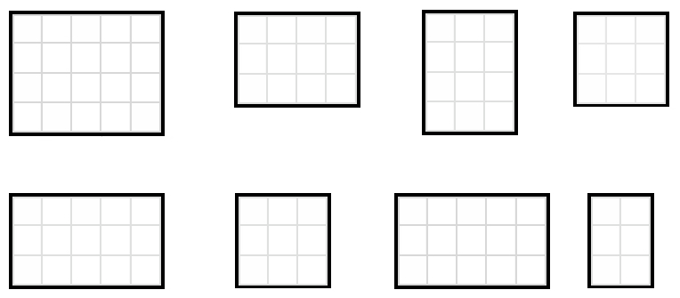
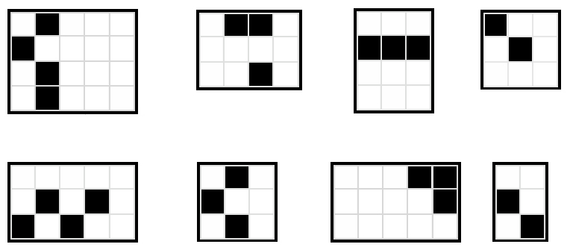

Slide 34
Stratified Sample Example
Population: all healthcare institutions in a county that perform surgery.
What to do:
Create a list of all healthcare institutions in the county that perform surgery.
Number them 1, 2, . . . , N where N is the total number of healthcare institutions (here N = 81).
Divide them up into distinct M categories and use an SRS or systematic sampling method. (here M = 8 and n = 24)

Slide 35
Benefits of a Stratified Random Sampling
Strengths
Reduced error and increases precision compared to SRS.
Guaranteed inclusion of members for each defined category.
Reduced sampling error.
Less variability than an SRS. (We’ll look at this later)

Slide 36
Drawbacks of a Stratified Random Sampling
Weaknesses
Can be expensive.
Stratifications must be implicitly defined.

Slide 37
When Should You Use a Stratified Random Sampling?
Strata is mutually exclusive.
Strata are collectively exhaustive.

Slide 38
Examples of Stratified Sampling
Sampling students by gender in a school by classroom.
Sampling people by country.

Slide 39
Cluster Sample
Population can be divided and subdivided into distinct groups, a sampling frame can be separated into what is labeled as strata.
Then simple random sampling or systematic sampling is applied within each stratum.

Slide 40

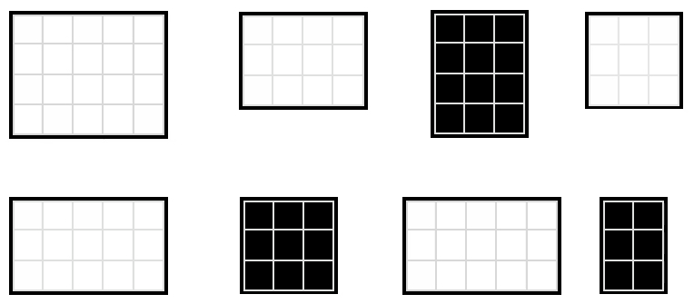

Slide 41
Cluster Sample Example
Population: all healthcare institutions in a county that perform surgery.
What to do:
Create a list of all healthcare institutions in the county that perform surgery.
Number them 1, 2, . . . , N where N is the total number of healthcare institutions (here N = 81).
Divide them up into distinct M categories and use an SRS or systematic sampling method. (here M = 8 and n = 27)

Slide 42
Benefits of a Cluster Random Sampling
Strengths
No need for a sampling frame.
Clusters can be stratified if necessary.
Cost efficient since clusters are housed close together (reduces the average cost per interview).
Increased precision from stratified sampling.

Slide 43
Drawbacks of a Cluster Random Sampling
Weaknesses
Requires a larger sample size than SRS.
May not represent diversity within a populous.
May have high sampling error.

Slide 44
When Should You Use a Cluster Random Sampling?
Clusters are mutually exclusive.
Clusters are collectively exhaustive.
Sampling selected clusters.
You do not have a full sampling frame.

Slide 45
Examples of Cluster Sampling
Selecting all houses in multiple blocks for sampling.
Sampling different classrooms in a school.

Slide 46
MIXED METHODS Pairings
There is no steadfast rule on what quantitative method goes with what qualitative method or visa versa.
Readings for this week will provide you with tested pairings.
If you are intending to do a mixed methods study where the survey is one component, let’s chat!

Slide 47
LESSONS ABOUT SAMPLE QUALITY
Features of Quality Samples
The population from which the sample was drawn is clearly specified
The sampling method (procedures) are clearly specified
High response rate
Researcher limits discussion about implications of their findings to the population from which they actually sampled

Slide 48
DETERMINING SAMPLE SIZE
Smaller Sample
Yields higher sample error
With homogeneous populations
For simple analysis
When strong relationship between variables is expected
Larger Sample
Yields lower sample error
With heterogeneous population
For complex analysis
When weak relationship between variables is expected

Slide 49
THANK YOU!

